Slide 1
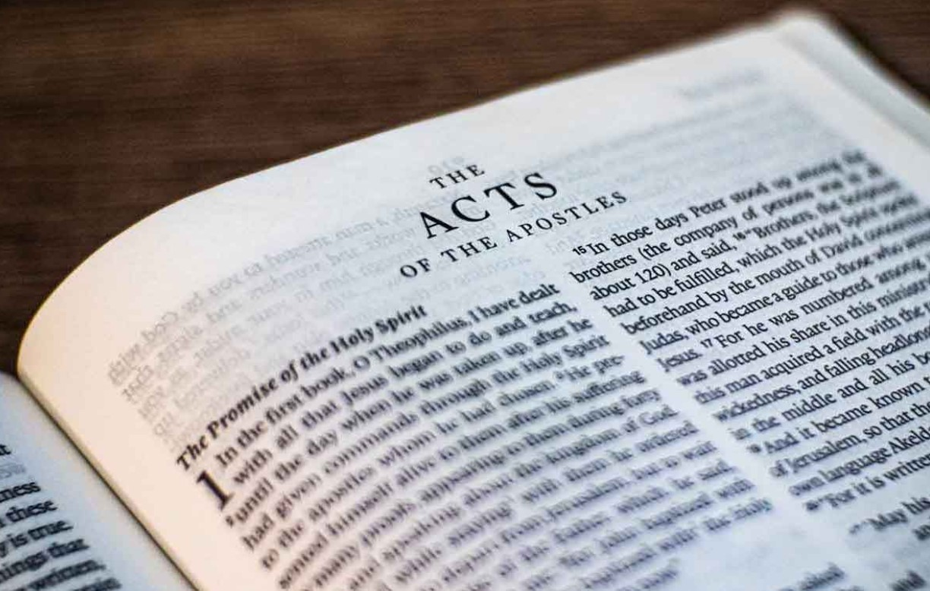
Go Tell The Good News
Acts – Part II

Slide 2
1)
2)
3)
4)
5)
6)
7)
8)
9)
10)
11)
12)
13)
14)
15)
Ascension & Appointment
Philippian Prison
16)
17)
18)
19)
20)
21)
22)
23)
24)
25)
26)
27)
28)
Pentecost & Peter’s Preaching
Addressing Athens
Lame Man & Lesson
Achaia, Antioch, & Apollos
Restrained, Released, & Request
Re-baptism, Repentance, & Riot
Deception & Detention
Macedonia & Miletus
Seven Selected
Jerusalem & Jewish Mob
Stephen Stoned
Review & Rejection
Samaria & Salvation
Council & Conspiracy
Saul Saved & Dorcas Delivered
Cornelius Converted
Report & Relief
A
Persecution, Peter, & Pride
CTS
Antioch to Iconium
F
Iconium to Antioch
ACTS
Disagreement & Decision
Alliteration Memory Statements To Help Recall Chapter Content

Slide 3
1)
2)
3)
4)
5)
6)
7)
8)
9)
10)
11)
12)
13)
14)
15)
Ascension & Appointment
Philippian Prison
16)
17)
18)
19)
20)
21)
22)
23)
24)
25)
26)
27)
28)
Pentecost & Peter’s Preaching
Addressing Athens
Lame Man & Lesson
Achaia, Antioch, & Apollos
Restrained, Released, & Request
Re-baptism, Repentance, & Riot
Deception & Detention
Macedonia & Miletus
Seven Selected
Jerusalem & Jewish Mob
Stephen Stoned
Review & Rejection
Samaria & Salvation
Council & Conspiracy
Saul Saved & Dorcas Delivered
Caesarean Confinement
Cornelius Converted
Appeal & Agrippa
Report & Relief
A
Review & Ridicule
Persecution, Peter, & Pride
Marooned On Malta
CTS
Antioch to Iconium
F
Rescued To Rome
Iconium to Antioch
ACTS
Disagreement & Decision
Alliteration Memory Statements To Help Recall Chapter Content

Slide 4
Today’s class:
Acts 23:11-35
Paul’s given confidence by the Lord
The vow to kill Paul
Paul’s escape to Caesarea

Slide 5
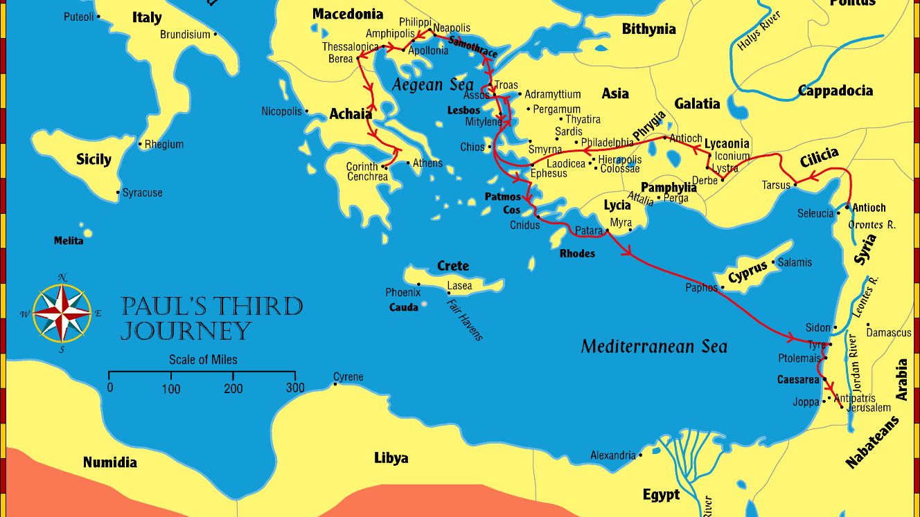
Paul goes “over that region and encouraged them with many words”
Summary
“Now I beg you, brethren, through the Lord Jesus Christ, and through the love of the Spirit, that you strive together with me in prayers to God for me, that I may be delivered from those in Judea who do not believe, and that my service for Jerusalem may be acceptable to the saints, that I may come to you with joy by the will of God, and may be refreshed together with you.”
Romans 15:30-32
2 Corinthians
Paul visits the churches established on 1st journey
Romans
Paul stays in Greece for 3 moths
Paul spends 3 years in Ephesus
Galatians (?)
1 Corinthians
Notes:
Review 3rd missionary journey
Reference the writing of the letter to Galatians (most probably) from Ephesus and also the 1st letter to the Corinthians
Reference the writing of the 2nd letter to the Corinthians while Paul is in Macedonia
Reference the writing of the letter to the Romans from Corinth
Paul then begins his trip to Jerusalem by going back through Macedonia (because of the plot of the Jews) and will be warned by the brethren in Tyre and Caesarea before arriving in Jerusalem.

Slide 6
Paul goes “over that region and encouraged them with many words”
Summary
Paul visits the churches established on 1st journey
Paul stays in Greece for 3 moths
Paul spends 3 years in Ephesus
Notes:
Review 3rd missionary journey
Reference the writing of the letter to Galatians (most probably) from Ephesus and also the 1st letter to the Corinthians
Reference the writing of the 2nd letter to the Corinthians while Paul is in Macedonia
Reference the writing of the letter to the Romans from Corinth
Paul then begins his trip to Jerusalem by going back through Macedonia (because of the plot of the Jews) and will be warned by the brethren in Tyre and Caesarea before arriving in Jerusalem.

Slide 7
Paul in Jerusalem
Summary
Falsely accused of desecrating the temple by allowing a Greek inside
Saved by Roman guard in court of Gentiles

Slide 8
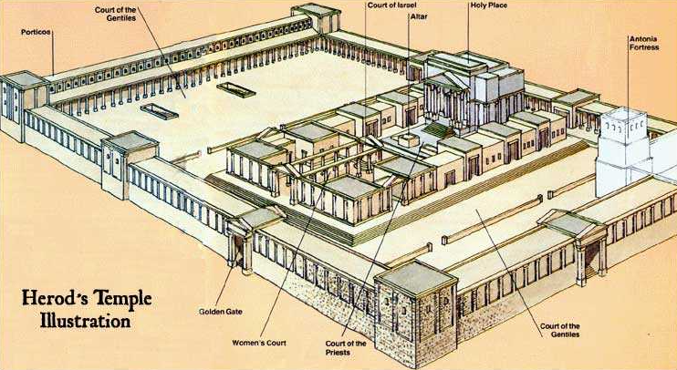

Slide 9
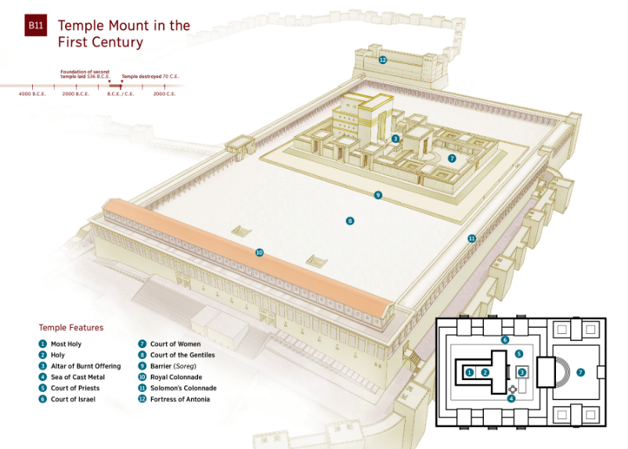
Fortress of Antonia

Slide 10
Paul in Jerusalem
Summary
Falsely accused of desecrating the temple by allowing a Greek inside
Saved by Roman guard in court of Gentiles
Summary of Paul’s defense before the people

Slide 11
Paul’s state of mind…
Summary
Previous warnings to Paul about his trip to Jerusalem:
Acts 20:22-23; Paul to the Ephesian elders, “chains and tribulations await me”
Acts 21:4; at Tyre – brethren tell Paul, through the Spirit, not to go to Jerusalem
Acts 21:10-14: Caesarea - Agabus prophesies about Paul being bound by Jews in Jerusalem, and the brethren plead with Paul not to go to Jerusalem

Slide 12
Paul’s state of mind…
Summary
Violence of the people:
Acts 21:30; mob seized Paul and dragged him out of the temple and sought to kill him
Acts 21:35; carried by the soldiers “because of the violence of the mob”
Acts 22:22-23; the people were riled up at Paul’s mention of the Gentiles
Acts 23:10; a great dissension among the council had the Roman commander fearing lest Paul might be pulled to pieces by them, Paul taken back to the barracks

Slide 13
Acts 23:11-22
The Lord stands by Paul
The vow by 40+ Jews to kill Paul
The providence of God demonstrated; Paul is saved from these men’s intention to cause harm
The Roman Commander recognizes a need to intervene

Slide 14
Acts 23:23-35
The Commander directs resources to ensure Paul is kept safe
The entourage, almost 500 soldiers and Paul, leaves Jerusalem and travels to Antipatris.
The horsemen and Paul continue to Caesarea

Slide 15
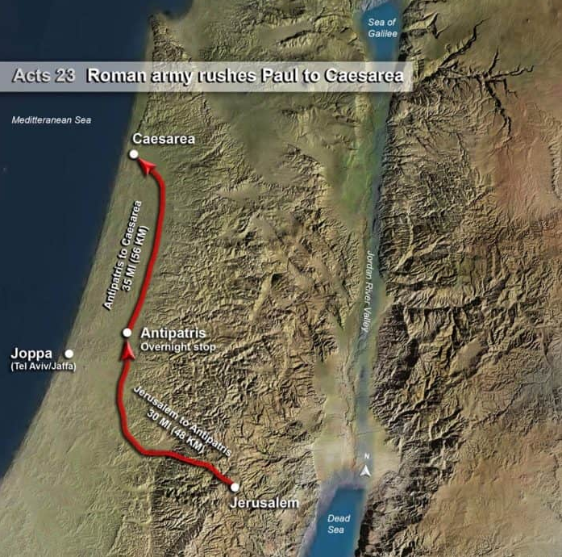
Antipatris: founded by Herod the Great around 9 BC, and it served as a significant military and administrative center. The city was strategically important due to its location on the Via Maris (Way of the Sea), an ancient trade route that connected Egypt with the northern empires of Syria, Anatolia, and Mesopotamia. This made Antipatris a vital link in the network of Roman roads, facilitating the movement of troops, goods, and information across the region.
Antipatris:
Acts 23:31

Slide 16
Caesarea: In ancient times, it boasted one of the world’s largest artificial harbors and was a center of Roman governance in the region. It was originally a small Phoenician town known as Straton’s Tower, and it was aggressively developed by Herod the Great into a major port city. Herod oversaw the construction of a massive artificial harbor, one of the largest in the world at the time, called Sebastos. Both the city of Caesarea and the harbor of Sebastos were named after Herod’s patron, Augustus Caesar (Sebastos being the Greek equivalent of Augustus). In addition to the artificial harbor, Herod built magnificent theaters, a palace, and an aqueduct.
Caesarea:
Acts 23:33

Slide 17
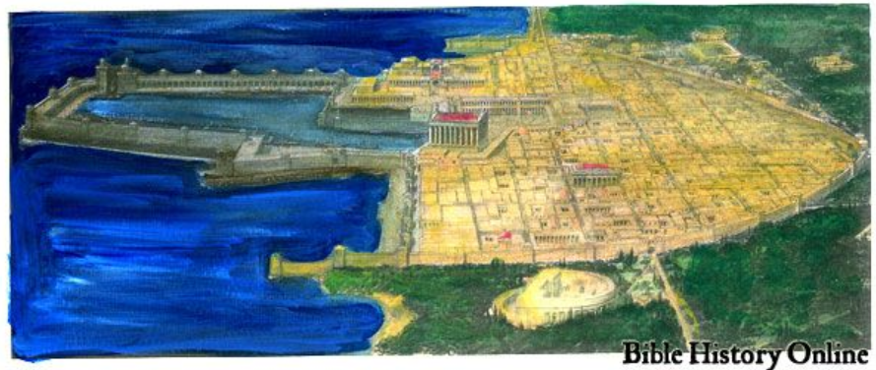
Caesarea: Acts 23:33

Slide 18
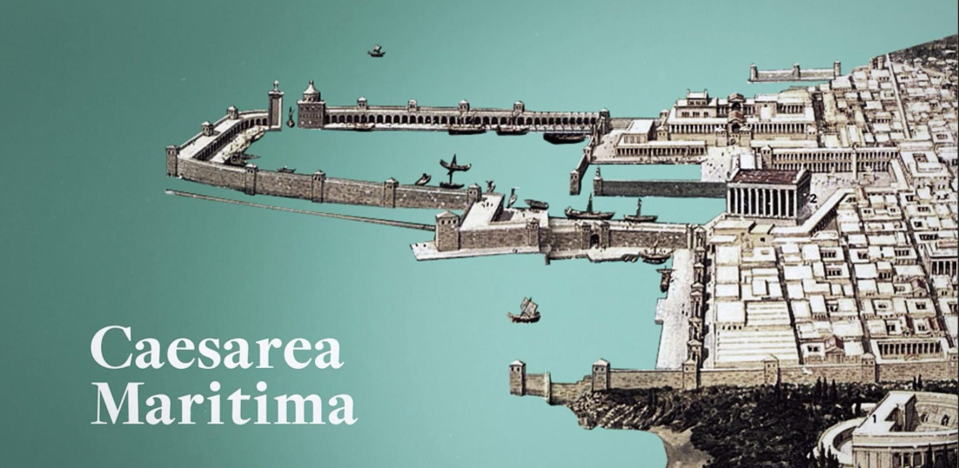
Caesarea: Acts 23:33

Slide 19
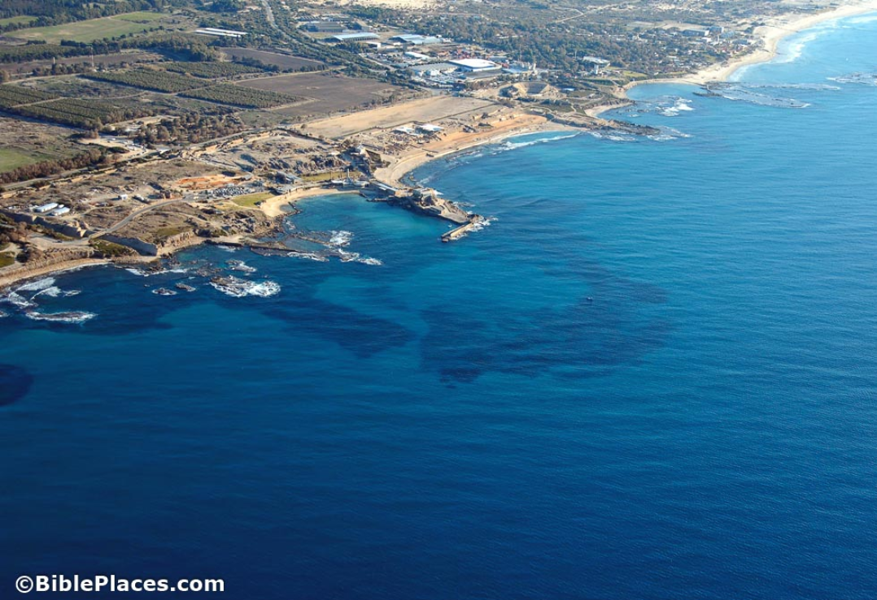
Caesarea: Acts 23:33

Slide 20
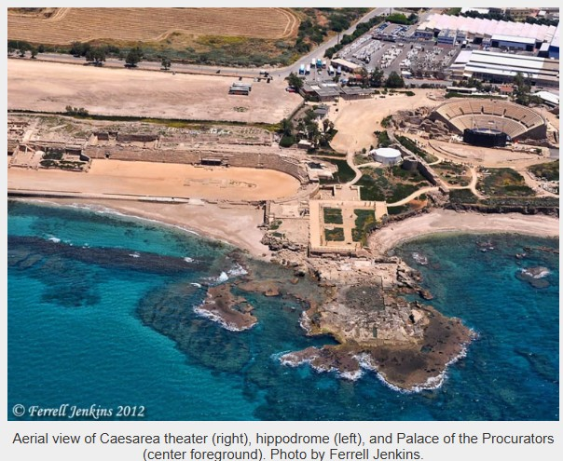
Caesarea: Acts 23:33

Slide 21
Acts 23:23-35
The Commander directs resources to ensure Paul is kept safe
The entourage, almost 500 soldiers and Paul, leaves Jerusalem and travels to Antipatris.
The horsemen and Paul continue to Caesarea
Claudius Lysias’ (Roman Commander at Jerusalem) letter to Felix, governor of Judea and Samaria
Paul placed in Herod’s Praetorium

Slide 22
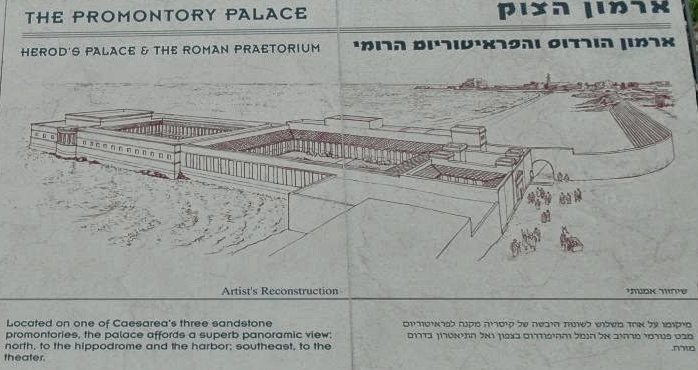
Caesarea: Acts 23:35

Slide 23
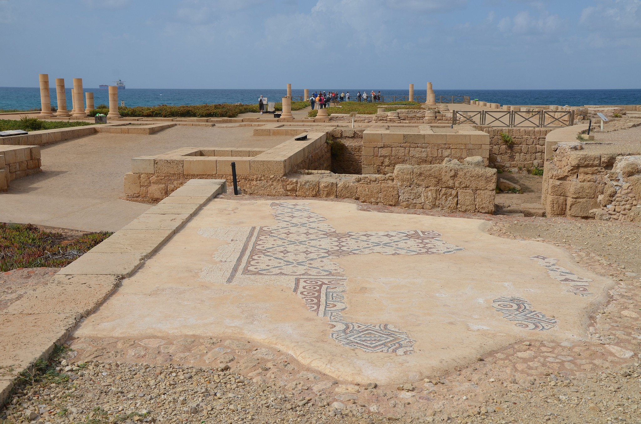
Caesarea: Acts 23:35
The Promontory Palace of Herod the Great stretching into the sea, Caesarea, Israel.

Slide 24
Acts 23:23-35
The Commander directs resources to ensure Paul is kept safe
The entourage, almost 500 soldiers and Paul, leaves Jerusalem and travels to Antipatris.
The horsemen and Paul continue to Caesarea
Claudius Lysias’ (Roman Commander at Jerusalem) letter to Felix, governor of Judea and Samaria
Paul placed in Herod’s Praetorium
Paul waits for his accusers to arrive in Caesarea

